Slide 1
Fiyaz Mohamed S
Naan Mudhalvan Project

Slide 2
PROJECT TITLE
FUEL EFFICIENCY PREDICTION USING FEEDFORWARD NEURAL NETWORK

Slide 3


AGENDA
In this presentation, We'll start with an introduction to the project goals and dataset. Then, we'll delve into data preprocessing, where we clean, explore, and engineer features for our model.
Next, we'll discuss the development of our feed-forward neural network using a sequential model approach, covering architecture and parameter choices. Following that, we'll evaluate the model's performance, examining metrics and learning curves.
Then, we'll present results and analysis, including insights gained from the model's predictions. Finally, we'll discuss deployment options and future steps.
3/21/2024 Annual Review

Slide 4

PROBLEM STATEMENT
The project aims to develop a robust predictive model for estimating vehicle fuel efficiency using a feed-forward neural network implemented in Python. With the automotive industry facing increasing pressure to optimize fuel consumption and reduce emissions, accurate predictions of fuel efficiency are essential.
Preprocessing dataset containing vehicle attributes such as engine displacement, horsepower, weight, and aerodynamic properties. Using a sequential model architecture, we build our predictive model, carefully selecting activation functions, optimizers, and loss functions.
Our model aims to provide stakeholders with valuable insights to inform decisions regarding vehicle design, fleet management, and energy-efficient technologies. Our project seeks to contribute to sustainable transportation practices by empowering stakeholders with a reliable tool for forecasting fuel efficiency and promoting environmental sustainability within the automotive sector.

Slide 5

PROJECT OVERVIEW
The project focuses on developing a predictive model using a feed-forward neural network to estimate vehicle fuel efficiency. This model is implemented in Python within a notebook environment.
The primary goal is to address the pressing need within the automotive industry for accurate predictions of fuel efficiency, crucial for optimizing fuel consumption and reducing environmental impact. The project begins with preprocessing a dataset containing various vehicle attributes, including engine displacement, horsepower, weight.
Evaluation metrics such as mean squared error and R-squared are utilized to assess the model's accuracy and generalization capabilities. The project aims to provide stakeholders with a valuable tool for making informed decisions regarding vehicle design, fleet management, and the adoption of energy-efficient technologies, thereby contributing to sustainable transportation practices and environmental sustainability within the automotive sector.

Slide 6

WHO ARE THE END USERS?
Automobile Manufacturers: Utilize the predictive model to optimize vehicle designs for improved fuel efficiency, thereby meeting regulatory standards and consumer demands.
Fleet Managers: Employ the model to optimize route planning and vehicle utilization, reducing fuel costs and environmental impact across their fleets.
Policy Makers: Leverage insights from the model to formulate and implement regulations aimed at reducing emissions and promoting the adoption of energy-efficient vehicles.
Consumers: Benefit from the availability of more fuel-efficient vehicle options and accurate information for making informed purchasing decisions, leading to reduced fuel expenses and environmental footprint.
Environmental Agencies: Utilize the model's predictions to monitor and assess the impact of transportation activities on air quality and greenhouse gas emissions, guiding policies for sustainable development.

Slide 7

YOUR SOLUTION AND ITS VALUE PROPOSITION
Accurate Predictions: The model provides precise estimations of vehicle fuel efficiency, enabling stakeholders to make informed decisions regarding vehicle design, fleet management, and energy-efficient technologies.
Cost Reduction: By optimizing fuel consumption, the model helps automobile manufacturers and fleet managers reduce operational costs associated with fuel expenses, leading to increased profitability.
Environmental Impact: The solution contributes to environmental sustainability by promoting the adoption of fuel-efficient vehicles and reducing greenhouse gas emissions associated with transportation activities.
Regulatory Compliance: By assisting in meeting regulatory standards for emissions and fuel efficiency, the model helps automobile manufacturers adhere to industry regulations and avoid penalties.
Consumer Benefits: Consumers benefit from access to more fuel-efficient vehicle options and accurate information for making informed purchasing decisions, leading to reduced fuel expenses and environmental footprint.

Slide 8

THE WOW IN YOUR SOLUTION
The wow factor in the above solution lies in its ability to harness cutting-edge machine learning technology, specifically a feed-forward neural network, to accurately predict vehicle fuel efficiency.
By leveraging advanced algorithms, the solution offers precise estimations that can revolutionize decision-making processes within the automotive industry and beyond. This predictive model has the potential to transform how automobile manufacturers design vehicles, how fleet managers optimize operations, and how policymakers shape regulations to promote environmental sustainability.
Overall, the wow factor lies in the transformative power of technology to address pressing challenges and drive meaningful change in the transportation sector.
3/21/2024 Annual Review

Slide 9
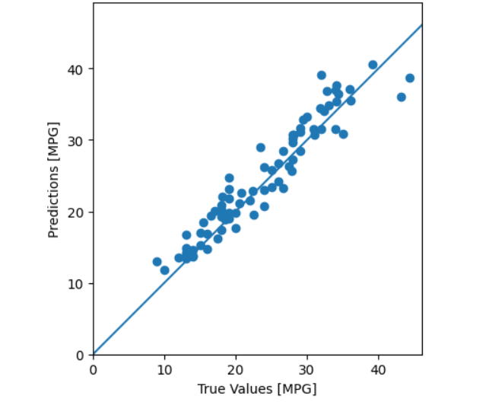
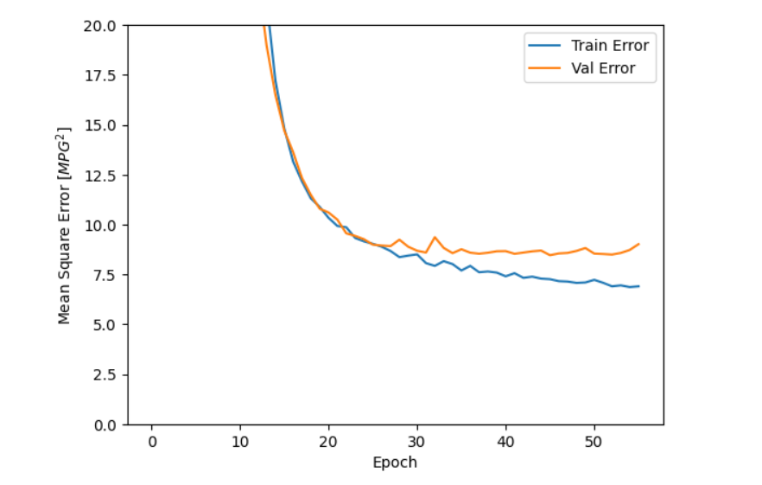
RESULTS

Slide 10
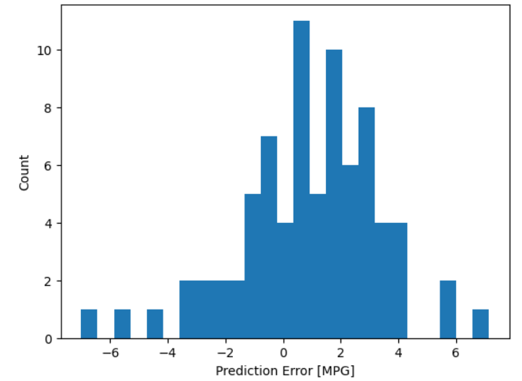
RESULTS
Accuracy:

Slide 11
Thank You

